Slide 1
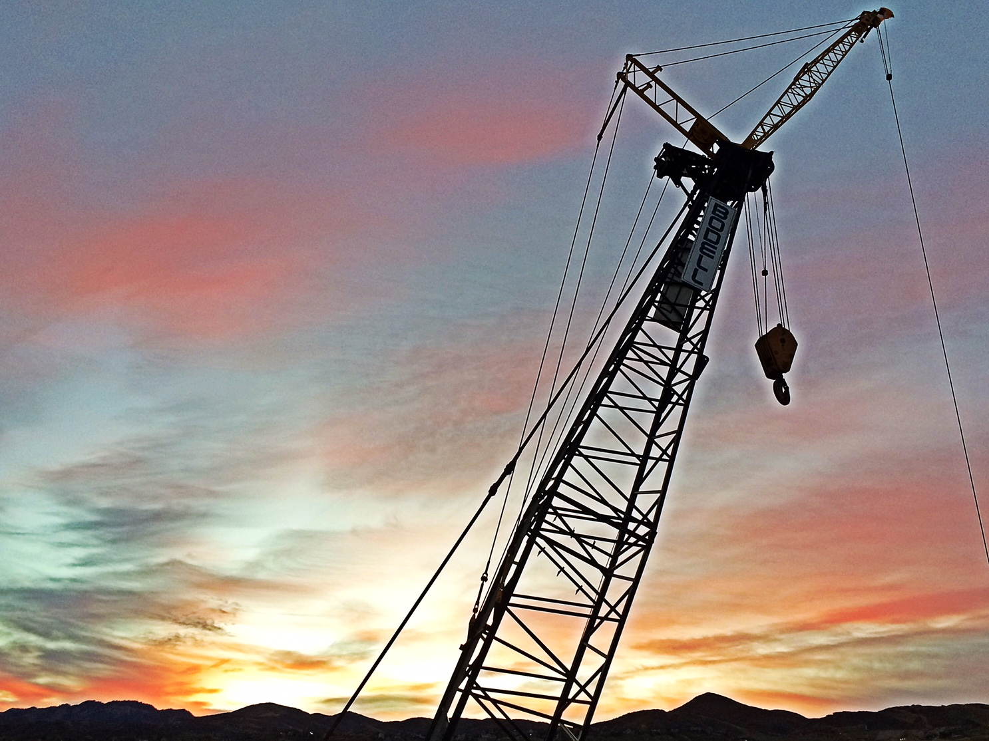
Winning Attributes

Slide 2
Organizational Vitality
The 6 E’s:
ENERGY
EDGE
ENGAGEMENT
EXCELLENCE in EXECUTION
EMPOWERMENT
ELIMINATE EXCUSES
Notes:
Vitality in a company presents itself in:
An Energetic, Thriving Workplace
Employees demonstrating Winning Attributes
A culture of sustained talent betterment/enhancement (development) and wellbeing

Slide 3
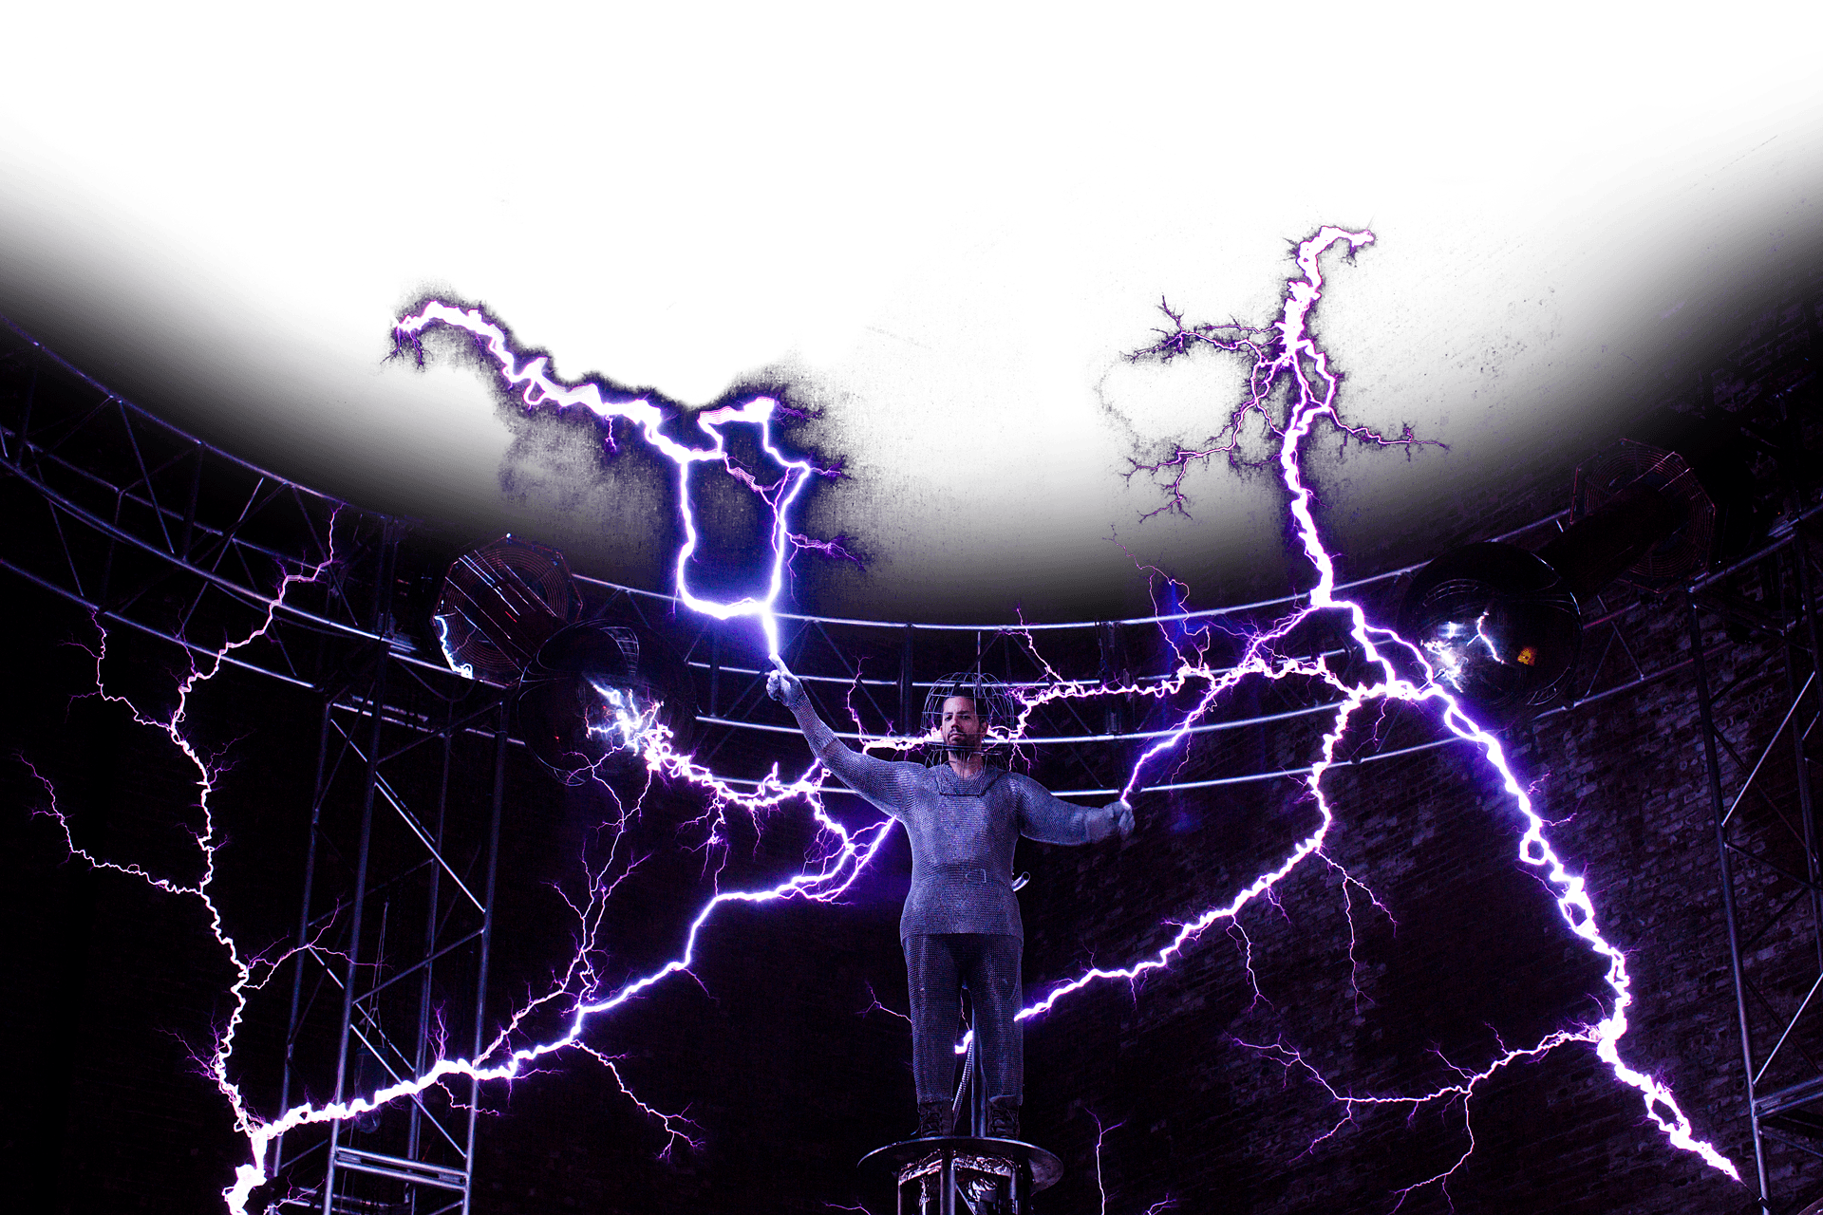
The 6 E’s - ENERGY
(For Self) Mentally and physically fit for duty, with a sense of excitement for what we do and enjoyment in what we are building here. (For Others) An ability to evoke energy in one’s coworkers.
Notes:
Energy – (Self) Mentally and physically fit for duty, with a sense of excitement for what we do and enjoyment in what we are building here. (Others) An ability to evoke energy in one’s coworkers.

Slide 4
The 6 E’s - EDGE
Find a sense of urgency and hone your relentless resolve to be your best.
Notes:
Edge – Find a sense of urgency and hone your relentless resolve to be your best. A sharp edge is useful, it’s accurate, it cuts cleanly

Slide 5
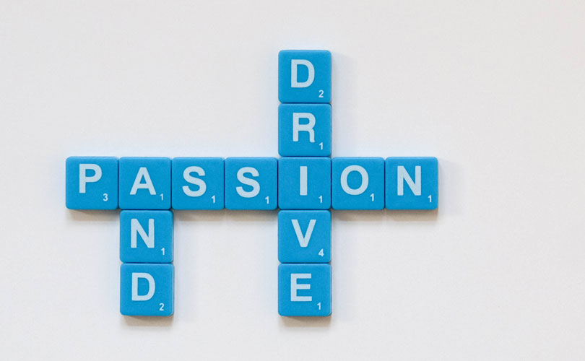
The 6 E’s - ENGAGEMENT
Engagement – Possessing drive, passion, focus, responsiveness. Being attentive to the details and never thinking or believing; “that is someone else’s problem.” Ask yourself: “If not me, then who? If not now, then when?
Notes:
Engagement – Possessing drive, passion, focus, responsiveness. Being attentive to the details and never thinking or believing; “that is someone else’s problem.” Ask yourself: “If not me, then who? If not now, then when?

Slide 6
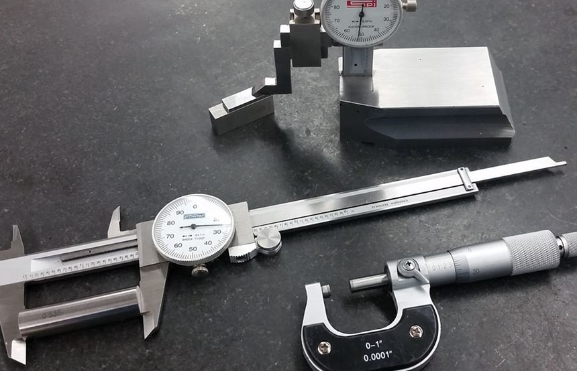
The 6 E’s – EXCELLENCE in EXECUTION
Acting on plans, delivering on commitments, being exceptional for its own sake, being precise, efficient, and maintaining predictability and order throughout the company.
Notes:
Excellence in Execution – Acting on plans, delivering on commitments, being exceptional for its own sake, being precise, efficient, and maintaining predictability and order throughout the company.

Slide 7
The 6 E’s - EMPOWERMENT
Empowerment – In oneself, through continuous professional enhancement and personal development; achieving a meaningful work experience, ongoing skill acquisition and elevated intellect. Empowerment of others, by sharing knowledge, wisdom and skills; gradually building strong, trusted employee leaders with ever greater autonomy.
Notes:
What do you want to be when you grow up?!
Empowerment – In oneself, through continuous professional enhancement and personal development; achieving a meaningful work experience, ongoing skill acquisition and elevated intellect. Empowerment of others, by sharing knowledge, wisdom and skills; gradually building strong, trusted employee leaders with ever greater autonomy.

Slide 8
The 6 E’s - ELIMINATE EXCUSES
We often find ourselves at a roadblock or stopping point when interfacing or collaborating with others. We’ve developed (over time) a propensity to exclaim:
I can’t because…
I’m waiting on…
I still need…
Let’s change the way we think here! Let’s take ACTION!
I could try…
I can talk with…
I will do…

Slide 9
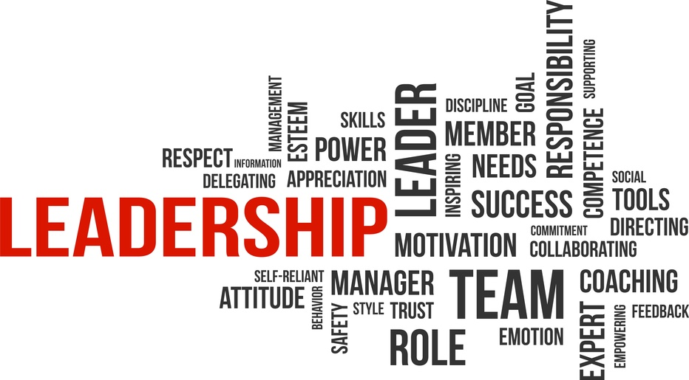
Talented Leadership

Slide 10
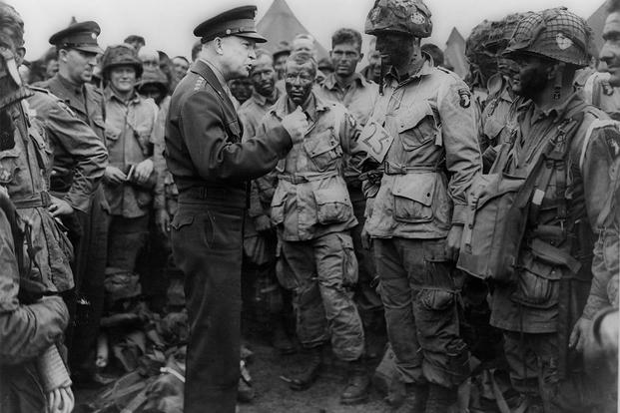
Winning Attributes
Winning Attributes for Effective Leaders
HAVE A VISION
BE FLEXIBLE
BE A TEACHER
HAVE HUMILITY
BE DISCIPLINED
COMMUNICATE EFFECTIVELY
DISPLAY HIGH EMOTIONAL INTELLIGENCE
MAINTAIN OUTSTANDING MANAGMENT PRACTICES
BE COMMITTED

Slide 11
Winning Attributes
Leadership at Bodell Construction:?
1. HAVE A VISION
Create a Plan
Take charge, be action-oriented
Lead
Act with urgency
Engage others to find the Better Way
2. BE FLEXIBLE
- Accept and embrace change – remember the cheese?
Innovate
Improve
Adapt

Slide 12
Winning Attributes
3. BE A TEACHER
Be an example
Coach
Mentor
Offer feedback
Be open to feedback
4. HAVE HUMILTY
Be teachable
Admit your mistakes
Learn from mistakes
Ask for help
Demonstrate integrity in the face of challenge
Credit the team

Slide 13
Winning Attributes
5. BE DISCIPLINED
Stay Focused
Make the difficult decisions
Avoid excuses
Relentless resolve for success
Play by the rules (Policies / Procedures / Contractual Obligations)
6. COMMUNICATE EFFECTIVELY
Have the information and share
Know your audience and tailor your approach accordingly
Be honest (candid)
Be tactful (respectful)
Implement the appropriate type of communication
In-person
Phone call
Text
Email

Slide 14
Winning Attributes
7. EMOTIONAL INTELLIGENCE
Self-awareness
Sympathy
Empathy
Perception
Motivation
8. OUTSTANDING MANAGEMENT PRACTICES
Plan
Be organized
Empower others (Delegate / Support / Accountability)
Be forward-looking
Be proactive

Slide 15
Winning Attributes
9. COMMITMENT
Commitment to success
Commitment to the team
Commitment to the Company
Commitment regardless of personalities, differences, beliefs, etc.
“Until one is committed, there is hesitancy, the chance to draw back, always ineffectiveness. Concerning all acts of initiative and creation, there is one elementary truth the ignorance of which kills countless ideas and splendid plans: that the moment one definitely commits oneself, then providence moves too.
All sorts of things occur to help one that would never otherwise have occurred. A whole stream of events issue from the decision, raising in one's favour all manner of unforeseen incidents, meetings and material assistance which no man could have dreamed would have come his way.
Whatever you can do or dream you can, begin it. Boldness has genius, power and magic in it. Begin it now.”
― William Hutchison Murray

Slide 16
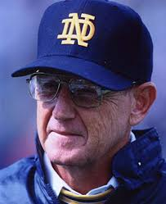
CONSIDER THIS
Ability is what you’re capable of doing. Motivation determines what you do. Attitude determines how well you do it.
-Lou Holtz

